Slide 1
Making this resource work for you
Prior to teaching this lesson, please refer to the ‘Unit Overview and Planning Document’.
Further guidance on planning Science Mastery lessons can be found in the detailed planning guidance document.
Refer to the ‘notes’ section on each slide for useful information, including suggested expositions, pedagogical content knowledge, suggested questions, answers and more. Consider using presenter mode so you can see this guidance throughout the lesson.
The introduction slides can be adapted to suit your teaching style and the needs of your class.
Before the lesson, adapt the fix-it slide to address any misconceptions identified in the previous lesson’s exit ticket.
Choose from the suggested activities to suit your class. The intention is not that you complete all of these, but that you select those which ones are most appropriate for your students. It may be appropriate to further adapt activities for your students.
These lessons are designed to occupy approximately 1 hour. To adapt for a shorter or longer lesson duration we advise you to adapt the activity section accordingly.
Please consider using the final slide to send feedback about this lesson or examples of PowerPoints that you have adapted to our design team. Your feedback is used to improve Science Mastery for all of our teachers and students. We appreciate all suggestions and comments.
Thank you for reading!
The Science Mastery Team

Slide 2
The Effect of Pollution on Biodiversity
Answer the following questions:
Define the term deforestation.
State three human activities that reduce biodiversity.
State three actions that can increase biodiversity.
Name the piece of equipment used in both random and systematic sampling.
Identify a biotic factor that can affect a community
The permanent removal of trees in forests to use land for a different purpose
Deforestation, waste disposal (landfill), peat bog destruction, quarrying, pollution (air and water)
Habitat protection, reducing deforestation, recycling to reduce landfill, growing hedgerows on farms, (non-selective) breeding programmes
Quadrat
Availability of food, a new predator, disease
Notes:
Purpose: to assess learning from the previous lesson.
Foundation question: List the sources of waste water from a home.
Answer: toilet, washing, shower, bath, food waste
Stretch question: Suggest how homes could minimise the amount of waste water they produce.
Answer: use shower water to flush toilets, reducing shower time, minimising loads of washing etc

Slide 3
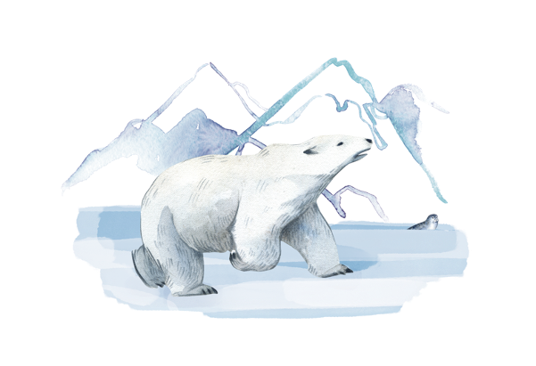
B3.2.5
12/04/2024
The Effect of Pollution on Biodiversity
B3.2.1 Prior Knowledge Review
B3.2.2 Biodiversity
B3.2.3 How Humans Affect Biodiversity
B3.2.4 How Humans can Preserve Biodiversity
B3.2.5 The Effect of Pollution on Biodiversity
B3.2.6 Global Warming
B3.2.7 Taking It Further: Pyramids of Biomass
B3.2.8 Taking It Further: Farming and Biotechnology
B3.2.9 Taking It Further: Food Security
Notes:
Big Idea: Organisms are Interdependent
Pupils have previously learnt about biodiversity and the effects humans have on organisms around them. This lessons focusses on pollution; the different types and what humans could do to reduce pollution.
Suggested Hook:
What is pollution? Some examples are air pollution including emissions from cars and aeroplanes, water pollution from industry, homes and farms and land pollution including landfill. There may be many answers particularly linked to the picture of the turtle on the screen which would link in with water pollution. Today we are going to look at different types of pollution. It is easy to think that pollution is a problem caused by big industries pumping chemicals into the air or sea- we have all seen these kinds of images. However, all humans contribute to pollution and some of this can be difficult to see. Let’s look at the different types of pollution, how scientists identify pollution levels and then importantly how we can and should reduce different types of pollution.

Slide 4

Following this lesson, students will be able to:
Describe the effect of the increasing human population on the amount of waste produced
Describe the different types of pollution
Describe some consequences of pollution
Key Words:
sewage
fertilisers
indicator species
contamination
leaching
Notes:
Can be edited depending on class need.

Slide 5
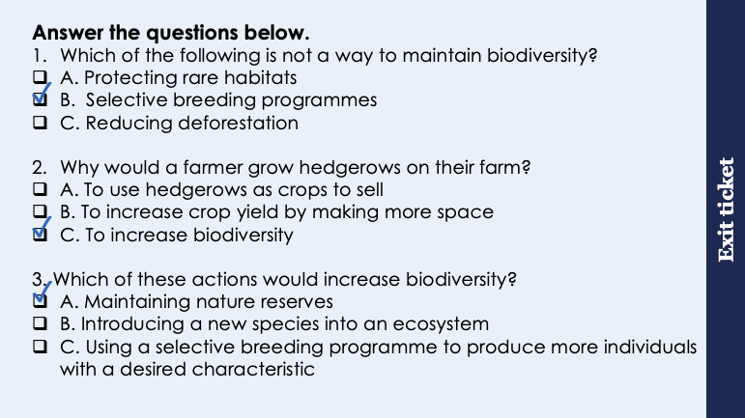
This is the fix-it portion of the lesson
The fix-it is an opportunity to respond to gaps in knowledge, especially those identified by the previous lesson’s exit ticket.
The teacher should customise this slide as needed, to facilitate
reteach, explanation, demonstration or modelling of ideas and concepts that students have not yet grasped or have misunderstood.
practise answering specific questions or of key skills.
redrafting or improving previous work.
Notes:
Purpose: to spend time on any gaps identified in previous learning from exit ticket feedback.
Suggested guidance based on previous exit ticket:
Q1. Answer: B
If students answer A or C, they have selected a way to maintain biodiversity, they may have fallen for the breeding programme. To fix-it briefly ask pupils what selective breeding means. Selecting for a genetic trait will reduce variation so reduce biodiversity. Breeding programmes that are for endangered species are different to selective breeding programmes.
Q2. Answer: C
If students answer A, they may have the misconception that hedgerows are crops, rather than a way to increase biodiversity by providing habitats for animals. If they answer B, this suggests a confusion of why hedges were originally removed as compared to growing them to increase biodiversity. To fix-it model a hedgerow on the board and ask pupils to explain why it would increase biodiversity- new species of plants and new habitats for insects and small animals.
Q3. Answer: A
If students answer A or B, they have not identified a way to increase biodiversity. To fix-it they may find it useful to be given more statements and sort these into increase/decrease biodiversity, similar to the question on the worksheet for this lesson. You may also want to get them to explain their reasoning for sorting statements so you can further identify where their misconceptions lie. Most likely they have chosen B and assumed that another species is always going to increase biodiversity – it may be useful to illustrate with a food web how this may not always be the case (e.g. where a stronger competitor outcompetes another and causes the weaker species to become endangered and decreases the amount of resources/food available).

Slide 6
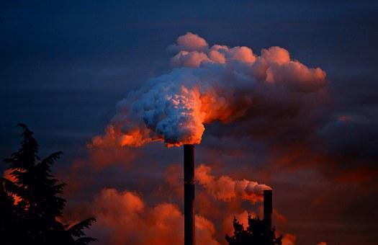
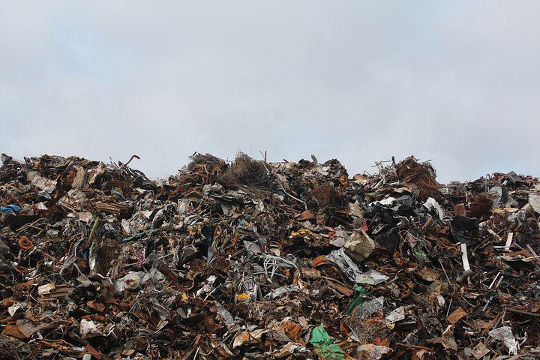
Human Waste
The human population is approximately 7.7 billion
The increase in population over the last century means there is a greater demand for resources and more waste is produced
Waste must be treated carefully to prevent pollution
Sources of air pollution include smoke and acidic gases
Sources of land pollution include landfill
Sources of water pollution include sewage, fertilisers and toxic chemicals
Notes:
Purpose: introducing new knowledge
Type of exposition: Explanation
Suggested Script:
The human population has been rising exponentially for the last century and is currently, approximately 7.7 billion!
This means there is more demand for resources (food, clean water, shelter etc) which causes various problems in society. How do you think this increase in demand for resources affects the waste that humans produce? Increased population using more resources means that more waste is produced.
This waste can be detrimental to the environment if not treated properly as pollution is gets worse when waste is not dealt with properly.
There are three main categories of pollution:
Air pollution comes from lots of industrial processes where smoke is released, containing carbon dioxide and sulfur dioxide amongst other things. Where else do you think air pollution comes from? Transport (cars, aeroplanes etc), any burning of fossil fuels e.g. wood burning fires. Cars used to produce lots of air pollution, although catalytic converters have reduced the quantity of toxic gases (e.g. carbon monoxide) by converting them into less toxic pollutants. What about electric cars? Electric cars do not produce air pollution themselves as they are not burning fuel however if the electricity used comes from a power station that does burn fossil fuels then air pollution is still being generated somewhere (although this will be to a far lesser extent than using petrol/diesel)!
Pollution also applies to land pollution, such as filling up landfill sites, which is removing habitats for some animals and plants.
Water pollution is mainly caused by lack of sewage treatment and eutrophication of fertilisers, which you may have learnt about in Geography. Water pollution can spread toxicity through food chains as it is absorbed by producers and then passed on to consumers.
Does pollution always kill animals? No. A common misconception here is that pollution always directly kills animals which is not the case – it may sometimes (e.g. toxic sewage killing aquatic life) but more often it damages their habitat or food source. Another misconception is that pollution universally affects all species equally, which is also not the case – some species are much more susceptible and some are much more resistant.
(there is a huge amount of further reading on this subject that more able pupils may be interested in. A good summary and place to start research is http://www.unece.org/environmental-policy/conventions/envlrtapwelcome/cross-sectoral-linkages/air-pollution-ecosystems-and-biodiversity.html)
Guidance: Humans also have a greater quality of life than ever before, including a consumer culture, which can make for an interesting debate about what resources are truly necessary.
Linking back to human effects on biodiversity - pollution can be extremely harmful to plants and animals (misconception is that pollution always kills organisms immediately, rather than being absorbed into food chains for example).
In terms of human health, air pollution is set to overtake poor water sanitation as a leading cause of death in humans.
It could be interesting to talk further about electric vehicles in big cities especially if pupils live in a big city. Air pollution may still be generated at the power plant but if this is far away from a city then the air quality of the city will not be affected therefore electric cars would be a good thing.
Images from pixabay

Slide 7
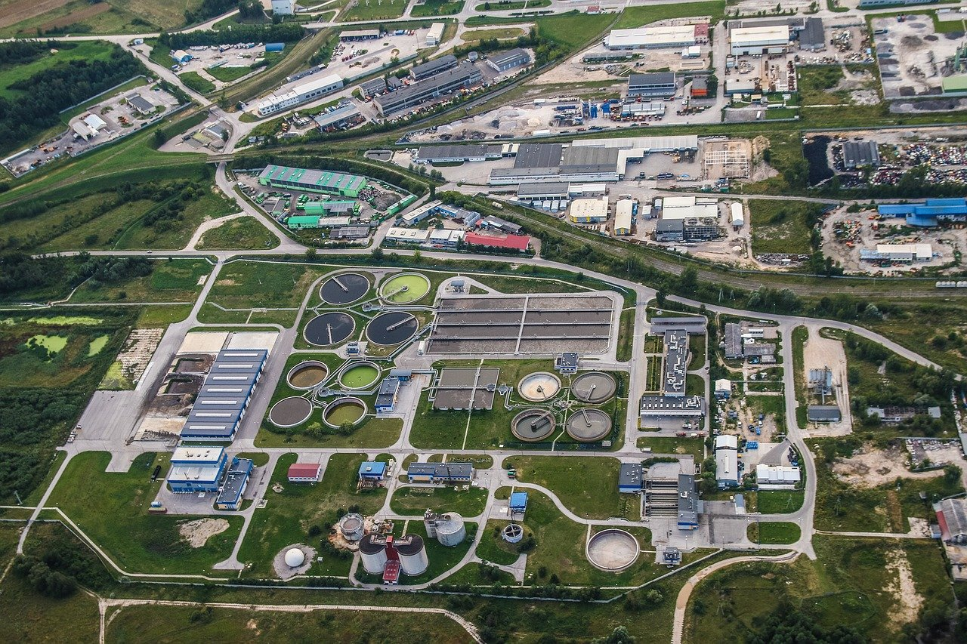
Waste water
The processing and treatment of waste water includes the following steps:
Screening and grit removal to take out large pieces
Sedimentation to separate sludge and effluent (the liquid that remains on top)
Sludge is digested by specific bacteria
Effluent is treated with specific bacteria and chemicals
Notes:
Purpose: introducing new knowledge
Type of exposition: Explanation
Suggested Script:
In many parts of the world open sewers run into streams and rivers, where humans obtain water from, thereby causing severe illness through contaminated water. Much waste water comes from sewage however it is good to remember that waste water also includes water that is used for household activities (showering, washing machines, sinks etc).
In order to prevent waste water from entering and polluting clean water sources the waste water must be removed and treated. This is done in 4 stages.
The first two stages are the physical water treatments. Screening (could link this back to filtration in separation techniques from C1.3) and sedimentation are used to remove any solids from the water using filtration.
Sludge is then treated with bacteria (could link to unicellular organisms knowledge from B1.1) so that it can be broken down safely.
The effluent is treated with bacteria and then chemicals to ensure the water is clean and safe to use.
Suggested guidance:
Image shows an arial view of a water treatment plant.
This is covered in much greater detail in C3.3 so for this unit pupils only need to have a basic understanding.
Image from pixabay

Slide 8
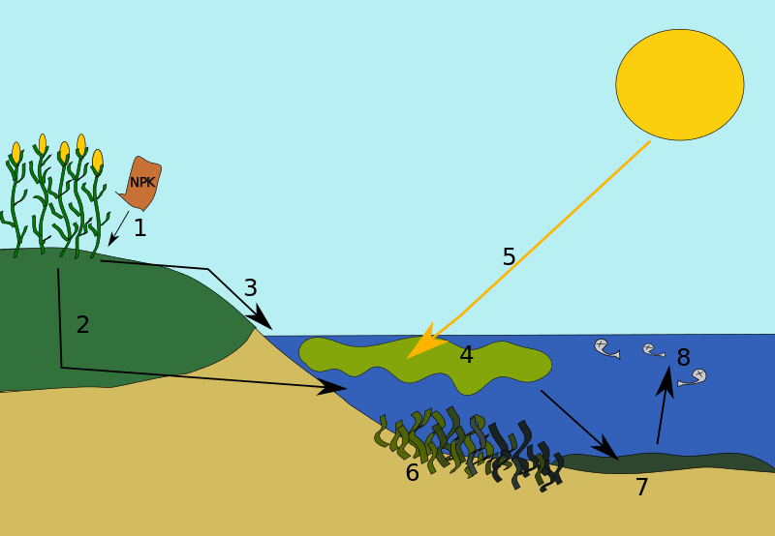
Eutrophication
Notes:
Purpose: introducing new knowledge
Type of exposition: Explanation
Suggested Script:
What happens if waste water from farms gets into rivers or streams? Pupils will likely answer that chemicals from the farm will kill organisms in the water. This is not always true and instead the process of eutrophication often happens.
Some farmers use too many fertilisers to promote growth of their crops, which can run off fields during periods of heavy rain, which then gets streams and rivers leading to eutrophication.
Eutrophication happens in these stages:
1- Fertiliser applied to crops
2/3- Fertilisers from farmers’ fields can leach into lakes, rivers streams etc.
4- The fertilisers which are rich in nutrients (nitrates and phosphates) can cause a rapid, explosive growth in plants and algae in the water
5- These plants and algae block sunlight from any plants beneath them. This means plants underneath cannot photosynthesise to survive and do not produce oxygen
6/7- The plants and organisms in the water die, decomposers (bacteria) break them down. Increased numbers of decomposers use up any remaining oxygen in the water
8- Finally, water that is completely depleted of oxygen becomes a dead zone and can no longer support life
Image source
https://commons.wikimedia.org/wiki/File:Eutrophicationmodel.svg

Slide 9
Quick Quiz
If these are the answers, what were the questions?
Greater demand for resources and more waste produced
Sewage, fertilisers and toxic chemicals
Production of any substances that are harmful to plants or animals
Fertilisers run into bodies of water causing explosive plant/algae growth that ultimately result in ‘dead zones’ of water.
What is the effect of the increasing human population?
What are the sources of water pollution?
What is pollution?
What is eutrophication?
Notes:
Purpose: review of new information.
Suggested guidance: Use MWBs/writing in books. Cold call or snowball questioning to develop best possible answers. Ensure that answers that are not completely correct are challenged

Slide 10

Can you explain the difference between these types of pollution?
Air Pollution
What are the causes?
What are the effects?
Stretch: which is more harmful?
Water Pollution
Notes:
Opportunity for pupils to explain the difference between air and water pollution. A common pupil error reported by GCSE examiners is where pupils answer the generic ‘pollution’ as a disadvantage to a huge number of questions, so this is a useful opportunity to help pupils become more specific and understand the difference.
Questions are suggested to help guide discussion, it may be useful to guide pupils towards a complete definition (which can be written down if useful):
Air pollution is caused by release of smoke, biological molecules or acidic/harmful gases into atmosphere, which causes death to humans and damage to living organisms like food crops.
Water pollution occurs by the contamination of water bodies like lakes, rivers, oceans and is harmful to biodiversity of aquatic ecosystems.
Suggested guidance:
Talk tasks can be used in a variety of ways to suit the particular needs of the students you are teaching. Through exchanging views with others, students develop their understanding of the science beyond what could be achieved individually.
Science classrooms that successfully integrate talk have the following features:
Science talk is a regular feature of lessons and is woven into classroom activities.
Students are paired or grouped strategically by the teacher to ensure productive interaction. This might take into consideration the students’ proficiency of the English language, how encouraging they might be to peers and their attainment in the topic. It’s a good idea to consider these pairings in the class seating plan.
Students are encouraged and supported to talk, but are not forced to talk.
The teacher should take on the role of a facilitator, engaging with conversations where necessary and encouraging or steering the conversation where needed.
Students are encouraged to use the language they have to express their ideas (e.g., everyday language, imperfect English, native language), but also to incorporate science specific terminology where this is more accurate or has been taught.
6. Scientifically inaccurate ideas are not dismissed by the partner or teacher; open discussion and further investigation are relied on to help students construct ideas that support them to progress in their scientific understanding.
7. Guidelines for behaviour during talk tasks are explicit and frequently reviewed. Rules for students might be:
Listen carefully to your partner
Take turns talking.
Speak one at a time, without interrupting.
Politely agree or disagree and explain why.
Politely point out if your partner has used a scientific word incorrectly, if they have explained the science incorrectly, or if there is a more accurate way to describe something.
If confused, ask questions.
Stay focused on the discussion topic.
Respond to one another.

Slide 11
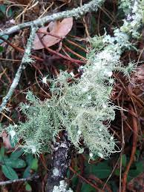
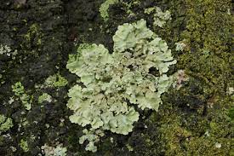
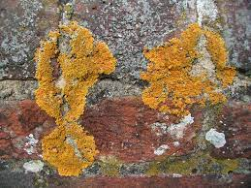
Indicator species - lichen and air pollution
Indicator species are organisms that can tell us about the levels of pollution in an area by their presence or absence.
Leafy lichen
Small amounts of air pollution
Crusty lichen
Higher amounts of air pollution
Bushy lichen
Clean air
Notes:
Purpose: introducing new knowledge
Type of exposition: Explanation
Suggested Script:
Scientists can use the presence or absence of certain species to deduce the levels of pollution in an area. Lichens can be used as air pollution indicators, they are especially sensitive to the concentration of sulphur dioxide in the atmosphere. Lichens are organisms that grow in exposed places such as rocks or tree bark. They need to be very good at absorbing water and nutrients to grow there. Air pollutants dissolved in rainwater, especially sulphur dioxide, can damage lichens and prevent them from growing. This makes lichens natural indicators of air pollution. If bushy lichen are present in an area it is an indicator that the air is very clean. Leafy lichen can withstand small amounts of air pollution whereas crusty lichen can survive in areas with more polluted air. If no lichen are present it is a sign that the air is heavily polluted with sulphur dioxide. Which type of lichen here would you expect to see growing on the side of a road? Crusty lichen.
Subject knowledge:
A lichen is a complex organism that is actually comprised of two symbiotic organisms: a fungus and an alga.
Image source:
https://commons.wikimedia.org/wiki/File:Bushy_beard_lichen.png
https://commons.wikimedia.org/wiki/File:Common_Greenshield_Lichen_-_Flavoparmelia_caperata_(39047420645).jpg
https://commons.wikimedia.org/wiki/File:N2_Lichen.jpg

Slide 12
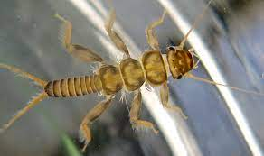
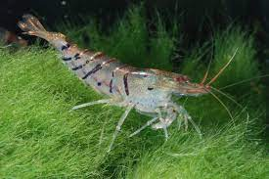
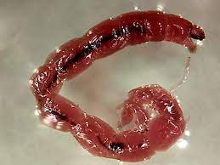
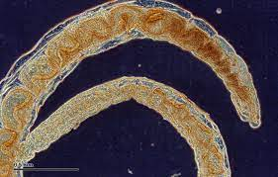
Indicator species - water pollution
Level of water pollution | Indicator species
Clean | Stonefly nymph
Some | Freshwater shrimp
Moderate | Bloodworm
High | Sludge worm
Very High | Absence of all living insects
Notes:
Purpose: introducing new knowledge
Type of exposition: Explanation
Suggested Script:
Many aquatic invertebrate animals cannot survive in water that has been polluted or has resulted in a lowering of the oxygen concentration, so their presence or absence indicates the extent to which a body of water is polluted.
Image source
https://commons.wikimedia.org/wiki/File:Stonefly_nymph_(5787610055).png
https://commons.wikimedia.org/wiki/File:Caridina-cf-cantonensis-tiger.jpg
https://commons.wikimedia.org/wiki/File:Single_Bloodworm.jpg
https://commons.wikimedia.org/wiki/File:Sludge_worm_(265_31)_Total_preparation.jpg

Slide 13
Drill
State the sources of air pollution.
State a source of land pollution.
State three sources of water pollution.
In the process of treating wastewater, name the process to:
Remove large pieces
Separate sludge
What the sludge is treated with?
What the effluent is treated with?
Define eutrophication.
Define indicator species.
Notes:
Purpose: This is a knowledge drill. The purpose of this is to check that the critical knowledge is secure before pupils move onto independent practice.
Suggested guidance: There are a range of ways this could be done depending on time and ability range of the class:
Mini whiteboards
As full sentences in exercise books
As short answers in exercise books
In the pupil workbook
As pair talk
As cold call

Slide 14
Drill answers
Smoke and acidic gases
Landfill
Sewage, fertilisers and toxic chemicals
Screening and grit removal
Sedimentation
Bacteria
Bacteria and chemicals
Excessive growth of plant life in a river/lake due to the run-off of fertilisers from crops
Indicator species are organisms that can tell us about the levels of pollution in an area by their presence or absence.
Notes:
Purpose: This is a knowledge drill. The purpose of this is to check that the critical knowledge is secure before pupils move onto independent practice.
Suggested guidance: There are a range of ways this could be done depending on time and ability range of the class:
Mini whiteboards
As full sentences in exercise books
As short answers in exercise books
In the pupil workbook
As pair talk
As cold call

Slide 15

I: Explain using scientific understanding to make something clear or state the reason for something happening
Example question:
To ‘explain’ your answer should:
Begin with a scientific statement.
Use ‘this means that’, ‘because’ or ‘so’ to link your statement to the question.
Farmers put fertiliser on their fields. When there is a lot of rain, some of the fertiliser is washed into the river.
Explain the effect of the fertiliser on the growth of plants/algae in the river
Model answer:
Fertiliser provides nutrients for plants/algae
Plants/algae grow excessively
Notes:
This slide models the process of answering an explain question.
Firstly, students are presented with a generic explain question, along with a model answer. Students are also given some simple guidance to follow for producing their own describe answer.
The generic question and answer should be used by the teacher to remind students of
the key features of a great answer
how to structure their answer
why the model answer is a good example
Following this, students will be required to apply this process to answer their own explain question, which will appear in place of the generic questions. This explain question will be specific to the topic students are learning about in the lesson. Give students time to write their own answer to this, ensuring that they use the guidance provided. To further scaffold this task for students, it may be appropriate to:
pair students up to write an answer together
list for students the key words you would like them to include in the answer
provide a writing frame or ‘points to include’ for students
A model answer for this question will appear. Teachers should review the model answer with students by referencing the guidance in the green box. For example ‘we can see item 1 in the guidance is to begin with a scientific statement. Notice in the model answer here we have done just that’. Or ‘item 2 in the guidance here says that we should use a linking statement in the answer. Has this been achieved in the model answer? Where can we see this?’.

Slide 16
We: Explain using scientific understanding to make something clear or state the reason for something happening
Example question:
To ‘explain’ your answer should:
Begin with a scientific statement.
Use ‘this means that’, ‘because’ or ‘so’ to link your statement to the question.
Two groups of students were monitoring the oxygen concentration in a river.
The results of Group 1 show the lowest concentration of oxygen was at sampling position X, directly below a field of farmers crops.
Explain why the concentration of oxygen was lowest at this point in the river.
Model answer:
Fertiliser runs off into river
Fertiliser causes growth of algae/plants
Algae/plants block light
Plants/algae die
Microorganisms decay plants/algae
Microorganisms respire so use O₂
Notes:
This slide models the process of answering an explain question.
Firstly, students are presented with a generic explain question, along with a model answer. Students are also given some simple guidance to follow for producing their own describe answer.
The generic question and answer should be used by the teacher to remind students of
the key features of a great answer
how to structure their answer
why the model answer is a good example
Following this, students will be required to apply this process to answer their own explain question, which will appear in place of the generic questions. This explain question will be specific to the topic students are learning about in the lesson. Give students time to write their own answer to this, ensuring that they use the guidance provided. To further scaffold this task for students, it may be appropriate to:
pair students up to write an answer together
list for students the key words you would like them to include in the answer
provide a writing frame or ‘points to include’ for students
A model answer for this question will appear. Teachers should review the model answer with students by referencing the guidance in the green box. For example ‘we can see item 1 in the guidance is to begin with a scientific statement. Notice in the model answer here we have done just that’. Or ‘item 2 in the guidance here says that we should use a linking statement in the answer. Has this been achieved in the model answer? Where can we see this?’.

Slide 17
You: Explain using scientific understanding to make something clear or state the reason for something happening
Example question:
To ‘explain’ your answer should:
Begin with a scientific statement.
Use ‘this means that’, ‘because’ or ‘so’ to link your statement to the question.
Farmers put fertiliser on their fields. When there is a lot of rain, some of the fertiliser is washed into the river.
This can cause the concentration of oxygen in the water to decrease
Explain why the concentration of oxygen decreases.
Model answer:
Fertiliser causes growth of algae/plants
Algae/plants block light
Plants/algae die
Microorganisms decay plants/algae
Microorganisms respire so use O₂
Notes:
This slide models the process of answering an explain question.
Firstly, students are presented with a generic explain question, along with a model answer. Students are also given some simple guidance to follow for producing their own describe answer.
The generic question and answer should be used by the teacher to remind students of
the key features of a great answer
how to structure their answer
why the model answer is a good example
Following this, students will be required to apply this process to answer their own explain question, which will appear in place of the generic questions. This explain question will be specific to the topic students are learning about in the lesson. Give students time to write their own answer to this, ensuring that they use the guidance provided. To further scaffold this task for students, it may be appropriate to:
pair students up to write an answer together
list for students the key words you would like them to include in the answer
provide a writing frame or ‘points to include’ for students
A model answer for this question will appear. Teachers should review the model answer with students by referencing the guidance in the green box. For example ‘we can see item 1 in the guidance is to begin with a scientific statement. Notice in the model answer here we have done just that’. Or ‘item 2 in the guidance here says that we should use a linking statement in the answer. Has this been achieved in the model answer? Where can we see this?’.

Slide 18
Explain: to use scientific understanding to make something clear or state the reason for something happening
A farmer uses fertiliser on his field. Later that day is rains heavily. The wastewater overflows into a stream by mistake.
The wastewater will affect the plants and invertebrates living in the stream.
Explain why.
To ‘explain’ your answer should:
Begin with a scientific statement.
Use ‘this means that’, ‘because’ or ‘so’ to link your statement to the question.
The fertiliser contains minerals (nitrates and phosphates) which increases the growth of algae and water plants.
These plants block light from reaching plants underneath causing them to die.
Decomposers break down the dead organisms, as they do this they use up oxygen in the water (through respiration).
Invertebrates in the water will then die due to lack of oxygen.
This process is called eutrophication.
Notes:
This slide models the process of answering an explain question.
Firstly, students are presented with a generic explain question, along with a model answer. Students are also given some simple guidance to follow for producing their own describe answer.
The generic question and answer should be used by the teacher to remind students of
the key features of a great answer
how to structure their answer
why the model answer is a good example
Following this, students will be required to apply this process to answer their own explain question, which will appear in place of the generic questions. This explain question will be specific to the topic students are learning about in the lesson. Give students time to write their own answer to this, ensuring that they use the guidance provided. To further scaffold this task for students, it may be appropriate to:
pair students up to write an answer together
list for students the key words you would like them to include in the answer
provide a writing frame or ‘points to include’ for students
A model answer for this question will appear. Teachers should review the model answer with students by referencing the guidance in the green box. For example ‘we can see item 1 in the guidance is to begin with a scientific statement. Notice in the model answer here we have done just that’. Or ‘item 2 in the guidance here says that we should use a linking statement in the answer. Has this been achieved in the model answer? Where can we see this?’.

Slide 19
Indicator Species
Distance from city centre (km) | Concentration of SO₂ (g/m³) | Number of different lichen species found on trees
0 | 300 | 1
5 | 212 | 5
10 | 145 | 10
15 | 77 | 14
20 | 75 | 14
Use data from the table above to answer the following questions:
Describe how the distance from the city centre affects the number of lichen species found.
Use the concentration of sulfur dioxide to explain the findings.
Notes:
Suggested script: The table shows the concentration of sulfur dioxide in the air at different distance from a city centre. It also shows the number of species of lichen found on trees at the same distances.
Answers are on the next slide

Slide 20
Answers
1) As the distance from the city centre increase from 0 – 15 km the number of lichen species found on trees increases from 1 - 14. As the distance increases from 15 – 20 km the number of lichen species remains at 14.
2) SO₂ levels decrease by approximately 70g/m³ every 5km away from the city centre up until 15km. This suggests that high SO₂ levels kills/reduces the survival of lichen.
Between 15-20km the levels of SO₂ remain similar which is reflected in the same number of lichen species being found at each distance.

Slide 21
Human Waste
Complete the Science in the News activity
Use full sentences
Write definitions for any words in bold
Watch the videos: where does human waste go?
Notes:
Purpose: practice application of new information – news article about the effect of more antibacterial substances being washed down drains, which is very relevant in the covid climate.
Alternative activities:
1. Where does human waste go?
Pupils rarely think about where toilet waste actually goes, so this can be really interesting for them to think about!
National Geographic link:
https://www.youtube.com/watch?v=YW6GBciRHLg
2. The Whitechapel fatberg from 2018 is now in the museum of London and the website has some great (disgusting) pictures and a lot of background information:
https://www.museumoflondon.org.uk/discover/exhibiting-fatberg-monster-whitechapel
This can form the basis of an interesting discussion on the causes – you may want to compare it to LDL cholesterol in blood vessels, modelling the effect this has on the ‘body’ (i.e. the city).
3. What is ecological sanitation and how can it be useful? Using waste as fertiliser to promote reforestation in Haiti:
https://www.youtube.com/watch?v=jmV_zyBJ3Z8

Slide 22
Answer the questions below.
Which correctly explains why humans are now producing more waste?
A. Humans now have a worse quality of life, fewer resources are used
B. The human population has increased hugely over the last century
C. Many resources can now be recycled so we can throw away non-recyclable items
2. Which is a consequence of not treating waste water?
A. Contamination of water sources, leading to severe illnesses
B. Factories illegally leaking toxic chemicals into streams and rivers
C. Run off of fertilisers from farms after heavy rain
3. Why is pollution bad for many plants and animals?
A. Pollution kills all plants and animals
B. Pollution is harmful for many habitats and can spread toxic substances through food chains
C. Pollution increases biodiversity
✓
✓
✓
Notes:
Q1. Answer: B
If students answer A or C, they have not identified the relationship between population size and amount of waste. To fix-it, it may be useful to use the analogy of doubling the number of students in a school. When the number of students doubles the amount of waste (food waste, paper etc) will also double.
Q2. Answer: A
If students answer B or C, they have confused cause and effect, so the error is most likely due to this misunderstanding rather than content. To fix-it, you could describe other cause and effect examples eg what is the consequence if you don’t do your homework? To find the effect, ask yourself: “What happened?” To find the cause, ask yourself: “Why did it happen?” Cause: didn’t do homework. Effect/consequence: school sanction.
Q3. Answer: B
If students answer A, they have the misconception that pollution must kill a organism. If they answer C, they have misunderstood either pollution or biodiversity. To fix-it, use an example where pollution does not directly kill the organism that ingests it but where bioaccumulation happens in a food chain. For example DDT (insecticide) can build up in a food chain and affect birds of prey at the top of the food chain even though they are not the ones who directly eat it.

Slide 23
Lesson B3.2.5
What was good about this lesson? | What can we do to improve this lesson?
Send us your feedback by clicking this link
or by emailing sciencemastery@arkonline.org
Thank you!

